Slide 1

Bootstrap
UIUC ECON 490: Applied Machine Learning in Economics

Slide 2

Bootstraps
Oldest boot dates to at least 10,000 BC

Slide 3
Parameter Distributions
Call:
lm(formula = log(value) ~ log(cost), data = ahs)
Residuals:
Min 1Q Median 3Q Max
-13.3136 -0.3516 0.0525 0.5125 5.0033
Coefficients:
Estimate Std. Error t value Pr(>|t|)
(Intercept) 6.89548 0.09867 69.89 <2e-16 ***
log(cost) 0.76836 0.01384 55.50 <2e-16 ***
---
Signif. codes: 0 ‘***’ 0.001 ‘**’ 0.01 ‘*’ 0.05 ‘.’ 0.1 ‘ ’ 1
Residual standard error: 1.017 on 9535 degrees of freedom
Multiple R-squared: 0.2442, Adjusted R-squared: 0.2441
F-statistic: 3081 on 1 and 9535 DF, p-value: < 2.2e-16

Slide 4
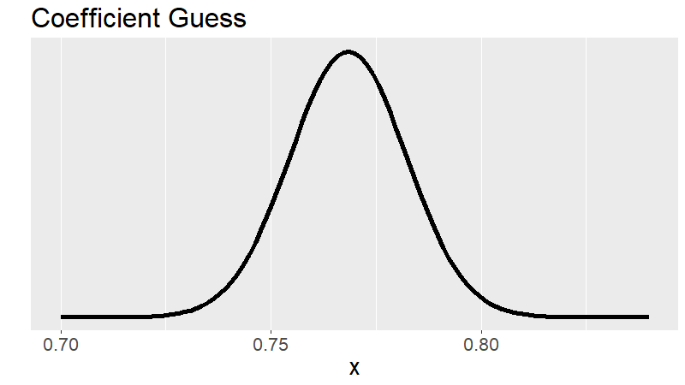
Parameter Distribution – Guess/Assume

Slide 5
The Bootstrap
Empirical Problems
Population of interest
Infinite
Sample from the population
Finite
Bootstrap
Sample from sample with replacement multiple times
Finite

Slide 6
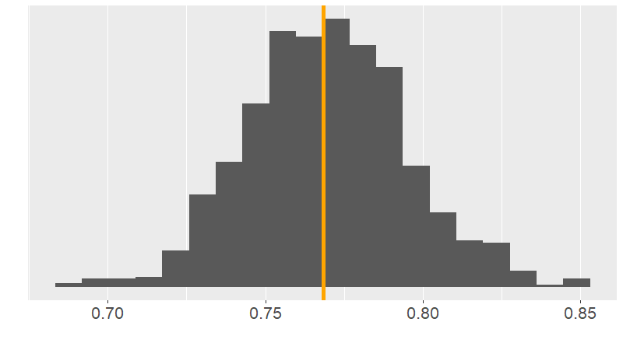
Parameter Distribution – Bootstrap

Slide 7
Nomenclature
“Pull yourself up by your bootstraps.”
Succeed on your own without help.
Normally need multiple independent samples to be confident of coefficients.

Slide 8
To Do
Complete
Lab 5.3.4
Read
Chapter 6.1

